Slide 1
Obliserv for Training

Slide 2
ENABLING OBJECTIVES
DEFINE Obliserv to Train (OTT)
IDENTIFY when OTT is authorized
DEFINE pg. 13 in Lieu of Obliserv
IDENTIFY when pg. 13 in Lieu of Obliserv is authorized
DEFINE a Conditional Reenlistment
IDENTIFY when a Conditional Reenlistment is authorized

Slide 3
References
MyNavy HR SRB SDAP Enlisted Bonus section: https://www.mynavyhr.navy.mil/Career-Management/Community-Management/Enlisted-Career-Admin/SRB-SDAP-Enl-Bonus/
MILPERSMAN 1160-030, Enlistments and Reenlistments Under Continuous Service Conditions
MILPERSMAN 1160-040, Extension of Enlistments
MILPERSMAN 1306-106, Time on Station (TOS) and Retainability Obligated Service (OBLISERV)
MILPERSMAN 1306-604, Active Obligated Service (Obliserv) for Service Schools
OPNAVINST 1160.8 (series), Selective Reenlistment Bonus Program

Slide 4
What is OTT?
(Obliserv to Train)
OTT is a OBLISERV option for Sailors with PCS orders to a NEC awarding course of instruction (A-School or C-School). *NEC must be listed in the most current SRB award plan*
OTT enables Sailors to be tentatively approved for an SRB prior to the course convene date, then reenlist for an SRB upon graduation.
This option is normally available for the following students:
  Fleet returnee who will be acquiring an SRB qualifying NEC
  PACT Sailor who will be acquiring a new rate/NEC which qualifies for SRB
  Sailor converting to a rate which qualifies for an SRB.

Slide 5
How does OTT work?
Sailor receives orders to an SRB awarding A or C School and graduation date occurs after Soft EAOS
Commands must forward all OTT requests to BUPERS-328 via NAVPERS 1306/7.
If approved BUPERS-328 will provide the OTT approval letter stating the qualifying NEC, current SRB award level and applicable SRB NAVADMIN
Service member must agree to obligate service in order to meet graduation date for qualifying SRB rating, NEC, or skill by signing a PG-13 and executing a short-term extension

Slide 6
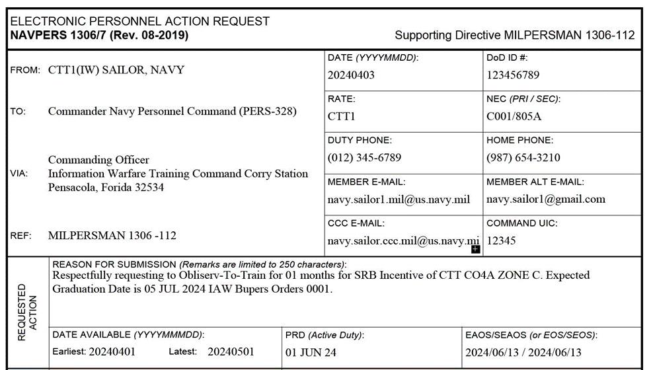
OTT REQUEST PROCESS
Prior to detaching to the service school, SVM will request OTT using a NAVPERS 1306/7 to BUPERS-328. Request must specify rating/NEC, months they are requesting to extend, and the orders number as listed below.
“Respectfully requesting to Obliserv-To-Train for ** months for SRB Incentive of RATE, NEC **** , ZONE *. Expected to Graduate DDMMYY IAW Bupers Orders ****.”
NOTE: Only request the number of months required to complete the NEC awarding school, to minimize monetary loss.

Slide 7
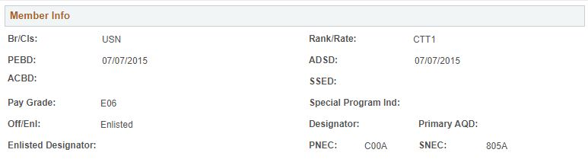
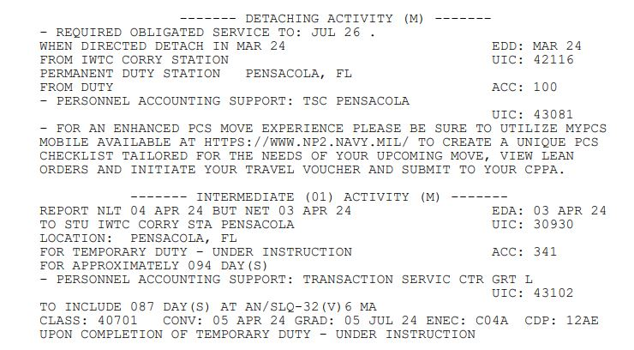
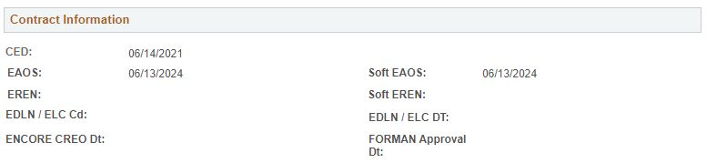
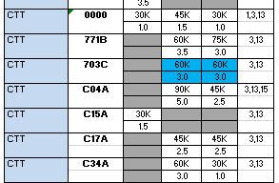
OTT REQUEST PROCESS
  How to identify required OTT information for the 1306/7 utilizing NSIPS
  NOTE: If a Sailor is set back in class, awaiting clearance, or the class is postponed, you will need to resubmit OTT paperwork with supporting documentation to BUPERS-328.
IDENTIFY ZONE
IDENTIFY CONTRACT TIMELINE
IDENTIFY SCHOOL, NEC, AND GRADUATION DATE
VERIFY SVM DOES NOT HAVE INOP/OPERATIVE EXTENSION ON CURRENT CONTRACT THAT WILL PLACE THEM OVER THE 48 MONTH LIMIT UTILIZING SERVICE OBLIGATIONS ON THEIR ELECTRONIC SERVICE RECORD VIA CIMS ACCESS ON NSIPS.
VERIFY RATE, NEC, ZONE, & SRB NOTES

Slide 8
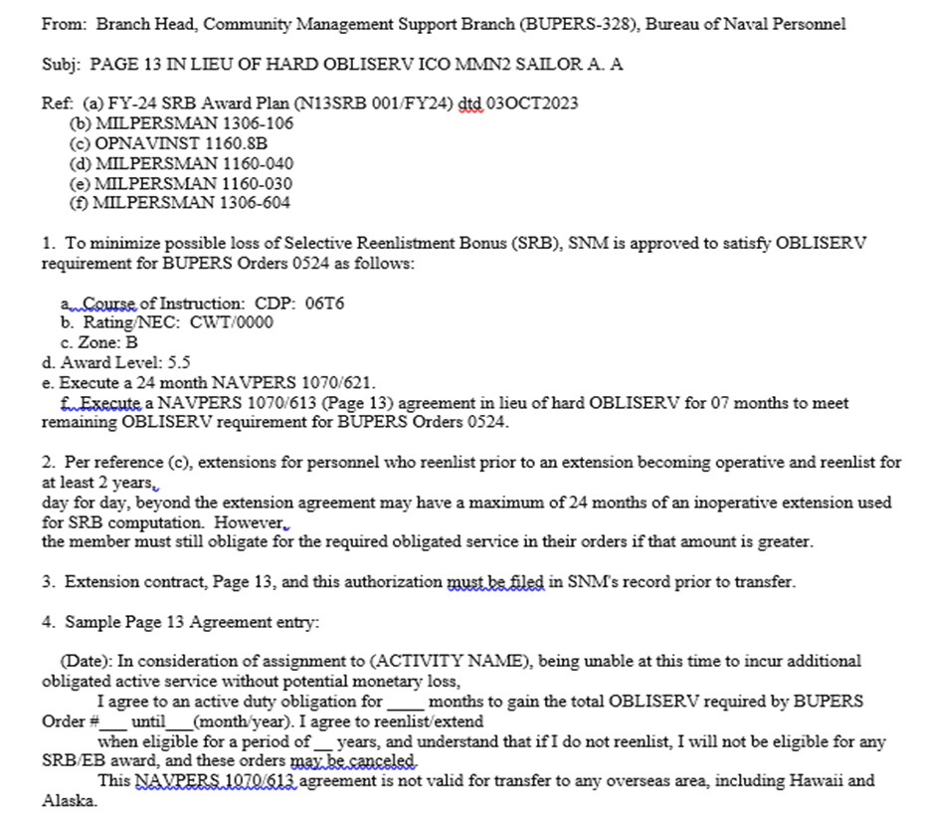
OTT REQUEST PROCESS
1306/7 will be routed and signed by the Commanding Officer and will be submitted to MNCC for processing.
BUPERS 328 will send an approval message
NOTE: The approval letter will be sent to the emails on the 1306/7
Verify NEC and award level
Verify how many months to extend for to meet OTT requirements
Use wording from this letter for the required PG-13
NOTE: Ensure you read the approval letter and review for accuracy. Any errors should be brought to the attention of BUPERS-328.

Slide 9
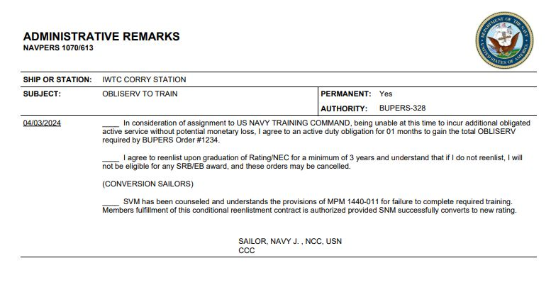
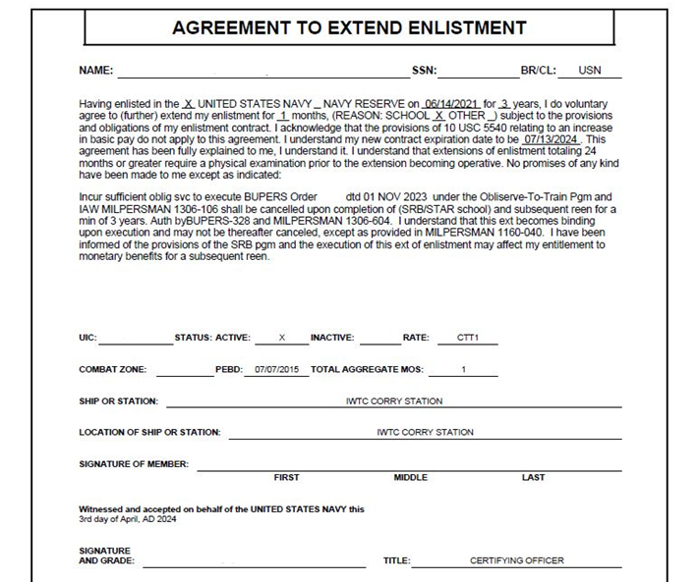
OTT REQUEST PROCESS
Once the OTT approval letter is received, generate the PG-13 IAW the letter and have the member sign the PG-13.
NOTE: Ensure the OTT extension is for the number of months directed by the OTT approval letter ONLY. Ensure that the reason for extension is for SCHOOL and the verbiage matches the required verbiage from the OTT approval letter.

Slide 10
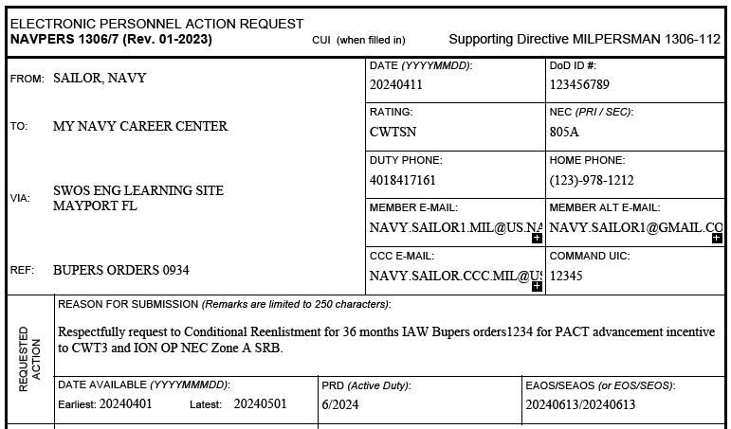
CONDITIONAL REENLISTMENT
(FOR TRAINING)
If a Sailor is eligible for OTT, but an extension would take them beyond the 48 month limit for extensions, the Sailor can request a conditional reenlistment to graduation date via BUPERS-328.

Slide 11
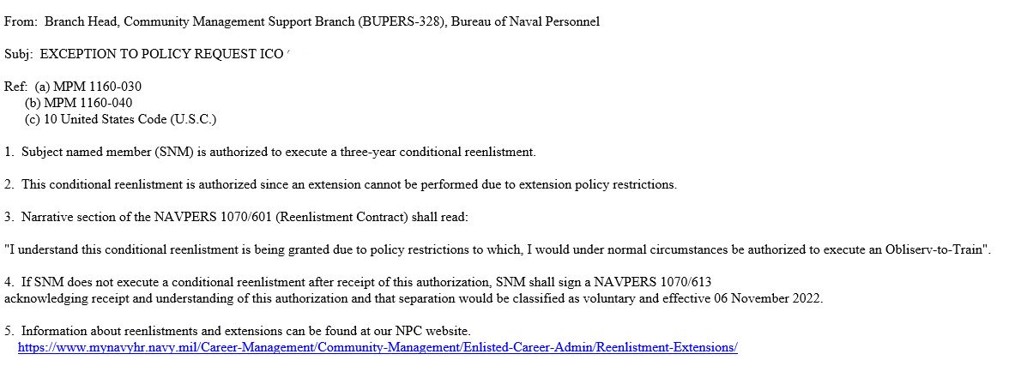
CONDITIONAL REENLISTMENT
(FOR TRAINING)
Once approved, an Exception to Policy (ETP) approval message will be sent by BUPERS-328. CCC will need to read the ETP to verify all requirements are met.

Slide 12
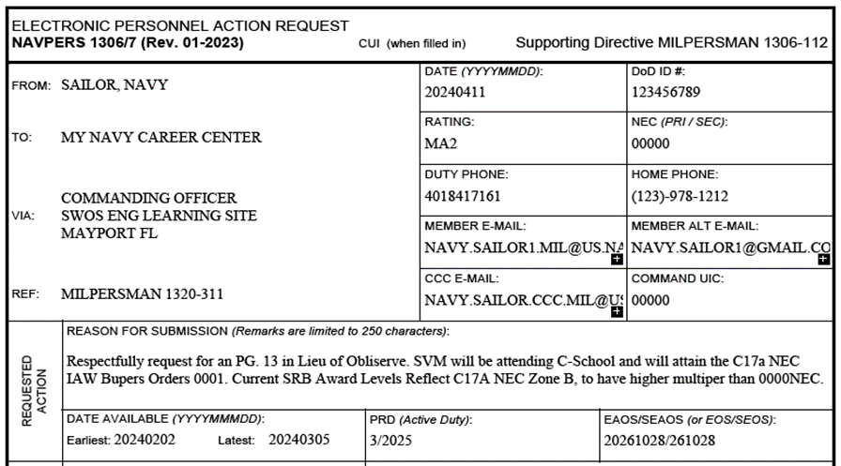
PG. 13 IN LIEU OF OBLISERV
If a Sailor’s S/EAOS is after the course graduation date, the Sailor is not eligible for OTT, however they are eligible to request a PG-13 in lieu of OBLISERV to prevent monetary loss and temporarily meet OBLISERV requirements.
The PG-13 in lieu of OBLISERV allows the Sailor meet OBLISERV requirements temporarily, pending course graduation. Sailor is required to meet OBLISERV upon course graduation or earning NEC.
NOTE: A request must be sent to BUPERS-328 for approval PRIOR to completing a PG-13 in lieu of OBLISERV and submitting to TSC for verification.

Slide 13
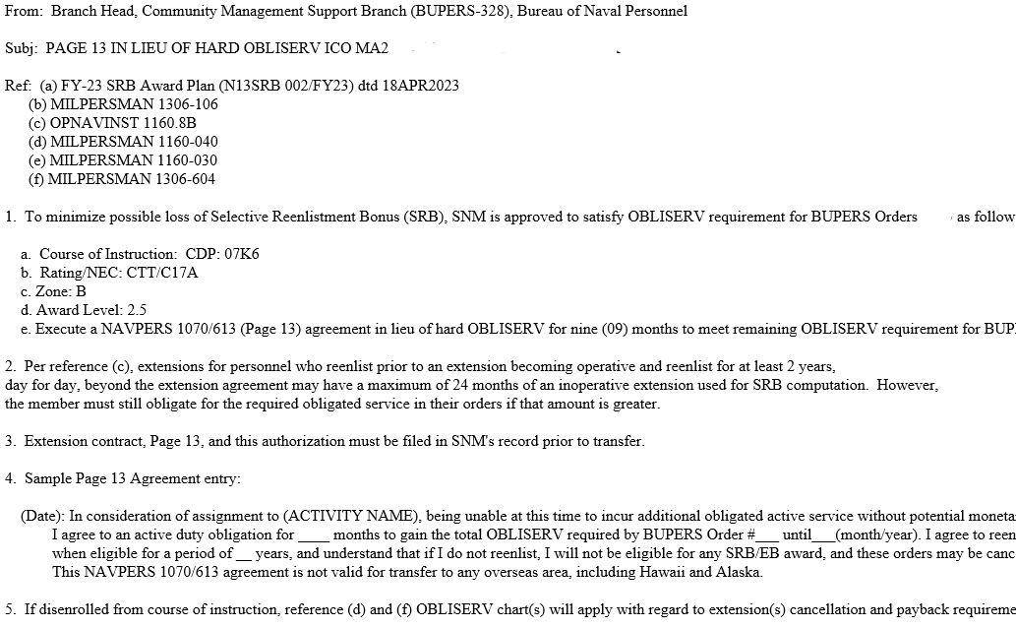
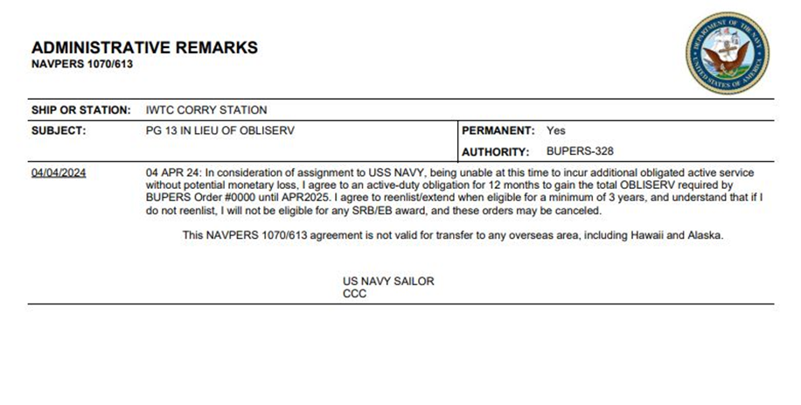
PG. 13 IN LIEU OF OBLISERV
An approval message will be sent from BUPERS-328
NOTE: Verify the information in the approval letter is correct prior to generating the PG-13.
NOTE: This is the ONLY authorized PG-13 in lieu of OBLISERV allowed and must only be requested if a Sailor would lose SRB money by executing their OBLISERV.

Slide 14
COMMON QUESTIONS
Q. Who submits the OTT request, the detaching command or the schoolhouse?
A. Remember, OTT is an OBLISERV. The Sailor shall not detach prior to meeting OBLISERV requirements, therefore the detaching command is responsible for the OTT request and/or approval.
Q. Can the schoolhouse CCC submit the SRB pre-cert for my Sailor?
A. Yes, however, if the Sailor will not meet the 35 day submission timeline, the detaching CCC should reach out to the schoolhouse. If in doubt, reach out.
Q. When is the Sailor required to reenlist?
A. Reenlistment will occur upon graduation with new rating and/or NEC.
Q. If a Sailor who is previously approved for an OTT is set back in training with a new graduation date beyond their EAOS, what do I do?
A. The training command CCC will submit another OTT request to BUPERS-328 with an updated roster showing the new graduation date. The OTT date will be updated in a new approval letter to reflect the changed date. **Another extension may be required for the Sailor, check the new approval letter**
Q. Is the SRB pre-cert a requirement?
A. Yes, the CCC needs to communicate with the training command prior to the Sailor arriving to ensure the SRB is handled by the new command.
Q. If Sailor is dropped from training, are they required to complete their executed extension?
A. Yes, they will be required to complete some or all of the extension IAW MPM 1160-030.
NOTE: It is good practice to always give your Sailors copies of their paperwork to take with them to the next command. This gives the training commands something to work with when we are helping these Sailors.

Slide 15
POINTS OF CONTACT
MYNAVY CAREER CENTER (MNCC) BUPERS-328
(901) 874 - 6622 (901) 874 - 3048
ASKMNCC.FCT@NAVY.MIL MILL_RE_EXT_CONV@NAVY.MIL
SRB HELP DESK NETC FORCE CAREER COUNSELOR
(901) 874 - 3215 (850) 452 - 4070
MILL_INCEN_PAYS.FCT@NAVY.MIL MARCELO.ALMONTE.MIL@US.NAVY.MIL
CIWT ISIC CCC CEODD ISIC CCC
(850) 452 – 6642 (850)-885-0575
TRAVIS.A.GREELEY.MIL@US.NAVY.MIL DAVID.B.BUTLER10.MIL@US.NAVY.MIL
IWTC CORRY STATION CCC SWSCOLCOM ISIC CCC
(850)-452-6218 (401)-841-7161
IWTC_CRRY_CCC@US.NAVY.MIL TIFFANY.A.MIDKIFF.MIL@US.NAVY.MIL

